Slide 1
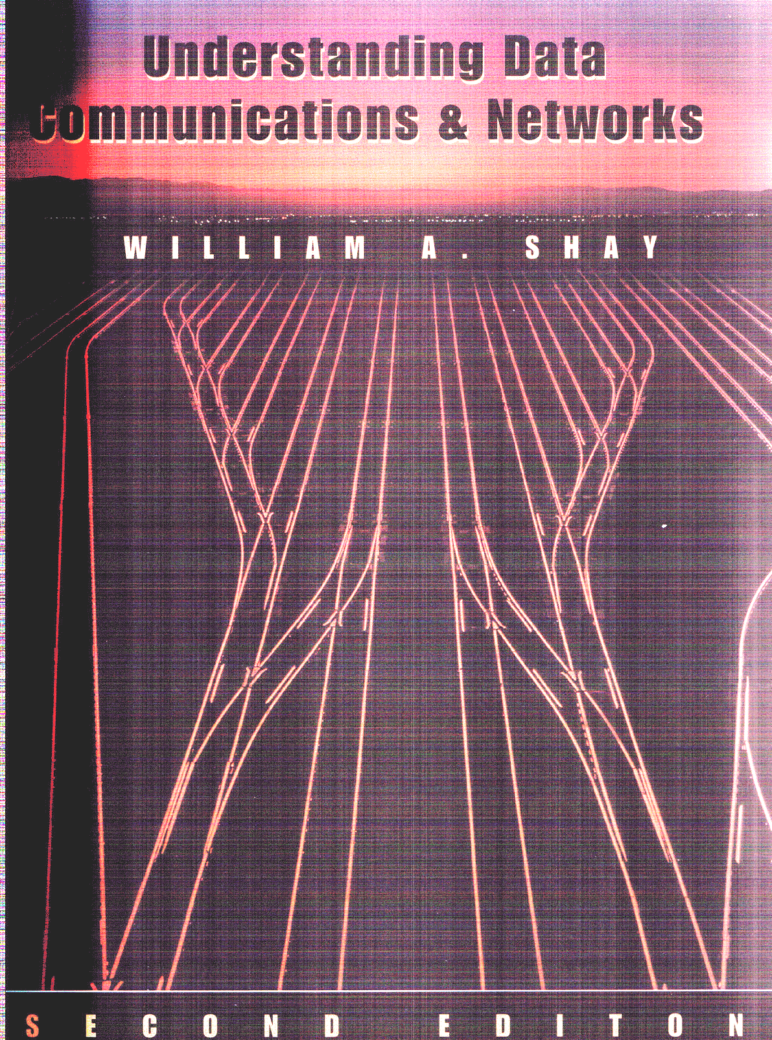
CSC 335 Data Communications and Networking
Lecture 1: Introduction to Communications
Dr. Cheer-Sun Yang

Slide 2
Communications
Data communication—examines how data, in the form of energy, travel across some medium from a source to a destination.

Slide 3
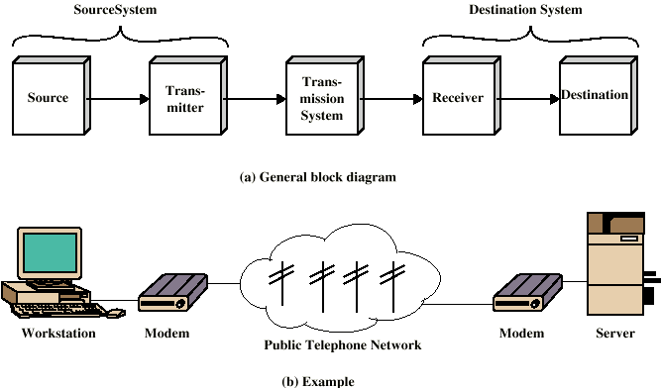
A Simplified Communications Model

Slide 4
Why study communications?
Why should we study communications?

Slide 5
A Brief History about Communications
1837- Samuel Morse invented the telegraph. Coding is done with the Morse code
1876- Alex. Graham Bell invented the telephone. Voice is converted into electrical energy and transmitted over a wire.
1945- ENIAC was invented as the first electronic computer
1980s-Personal Computers become a new way of computing
1990s-came the emergence of the Internet and World Wide Web applications

Slide 6
What are transmitted via Communication Media?
Voice – encoded signals
Video – encoded images
Data – character streams

Slide 7
Communication Applications
Voice – telephone, FAX, Video Conferencing, Cellular phones, etc.
Video & Audio – television, VCR, DVD, etc.
Data – LAN, WAN, Internet, etc.

Slide 8
Networking
Networking—computers communicate with each other via networks.
Computer network—a communication system for connecting computers using a single transmission technology.

Slide 9
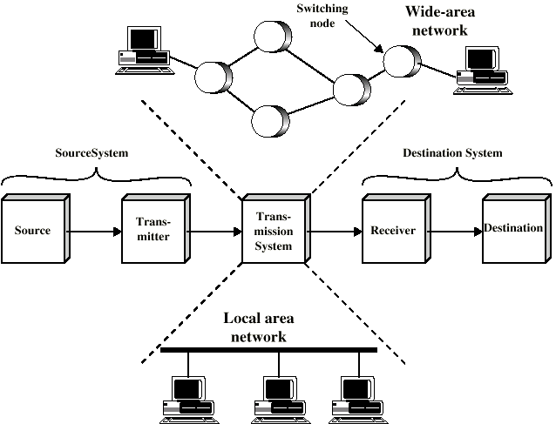
A Simplified Network Model

Slide 10
Network Topology
Bus topology
Star topology
Ring topology
Fully connected topology
Combined topology

Slide 11
Protocols
Definition – all parties involved in a communication must agree in a set of rules to be used when exchanging messages. Thus, the set of rules which both the sender and the receiver all comply with is called protocol.
A protocol specifies the message format, meanings, and the procedures is known as a communication protocol.
A communication application doesn’t communicate with the communication hardware directly.

Slide 12
Key Elements of a Protocol
Syntax
Data formats
Signal levels
Semantics
Control information
Error handling
Timing
Speed matching
Sequencing

Slide 13
Why Protocols?
Used for communications between entities in a system
Must speak the same language
Entities
User applications
e-mail facilities
terminals
Systems
Computer
Terminal
Remote sensor

Slide 14
Communication Reference Models
In summary, we need a communication reference model to describe the relationship between various software and hardware.
A reference model describes the layering relationship of software and hardware involved in the communication.
A layered protocol performs specific functions and communicates with the layers directly above and below it.

Slide 15
Communication Reference Models
The purpose of layering the protocol is to separate specific functions and to make their implementation transparent to other components.
Advantage of layered approach: independent design and testing of each communication software component
Disadvantage: overly layering can affect performance negatively.

Slide 16
A Communications Model
Source
generates data to be transmitted
Transmitter
Converts data into transmittable signals
Transmission System
Carries data
Receiver
Converts received signal into data
Destination
Takes incoming data

Slide 17
Protocol Architecture
Task of communication broken up into modules
For example file transfer could use three modules
File transfer application
Communication service module
Network access module

Slide 18
Protocol Data Units (PDU)
At each layer, protocols are used to communicate
Control information is added to user data at each layer
Transport layer may fragment user data
Each fragment has a transport header added
Destination SAP
Sequence number
Error detection code
This gives a transport protocol data unit

Slide 19
Standards
Required to allow for interoperability between equipment
Advantages
Ensures a large market for equipment and software
Allows products from different vendors to communicate
Disadvantages
Freeze technology
May be multiple standards for the same thing

Slide 20
Categories of Protocols
Proprietary system– designed and developed for supporting the communications of machines manufactured by a specific vender
System Network Architecture (SNA) was designed and developed for connecting IBM main frame computers and peripherals (workstations, printers, tape drives, etc.)
NetBEUI – Microsoft’s protocol for simple Windows networks
IPX/SPX (Internetwork Packet Exchange and Sequenced Packet exchange) – support Novell NetWare products

Slide 21
Categories of Protocols
Open systems– publicly proposed and evaluated protocols for supporting the internetworking of heterogeneous machine
Open System Interconnect (OSI) was developed by ISO
TCP/IP was designed by IETF (Internet Engineering Task Force), another volunteer organization for the engineering issues of the Internet.

Slide 22
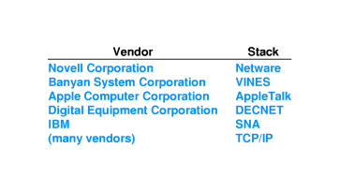
Examples of Protocol Stacks

Slide 23
OSI Model
Open Systems Interconnection (OSI)
Developed by the International Organization for Standardization (ISO)
Seven layers
A theoretical system delivered too late!
TCP/IP is the de facto standard

Slide 24
OSI Layers
Application
Presentation
Session
Transport
Network
Data Link
Physical

Slide 25
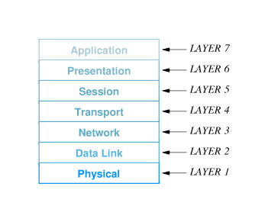

Slide 26
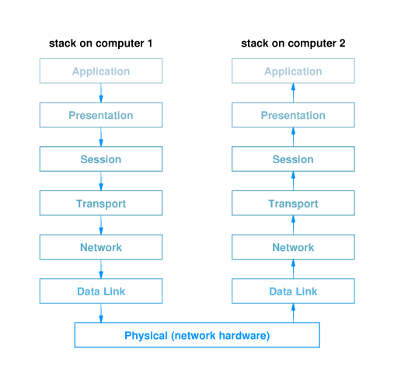

Slide 27
Physical Layer
Corresponds to basic hardware.
Example: NIC, modem, cable
Topics include transmission media, data encoding, modulation/demodulation, multiplexing, switching(layer 1)-- circuit switching.

Slide 28
Data Link Layer
Specifies how to organize data into frames and how to transmit frames over a network.
Detail topics include the format of a data frame, i.e., framing, error detection/correction, frame level error recovery.

Slide 29
Network Layer
Specifies how to assign addresses and how to forward packets to its destination.
Detail topics include fragmentation, assembly, routing, flow control.

Slide 30
Transport Layer
The basic function of the transport layer is to accept data from the session layer, split it up into smaller units, if needed, pass them to the network layer, and ensure that the pieces all arrive correctly at the other end.
The transport layer also determines the type of services, connection-oriented or connectionless.
Congestion control

Slide 31
Session Layer
Allows users on different machines to establish sessions between them.
Major functions include managing dialog.
Session layer determines whether traffic can only go in one direction or both directions at the same time.

Slide 32
Presentation Layer
Controls the encoding and decoding of data, data compression.

Slide 33
Application Layer
Controls the interface with users.
Application, presentation, session layers are usually implemented together instead of using laying architecture.

Slide 34
TCP/IP Protocol Architecture
Developed by the US Defense Advanced Research Project Agency (DARPA) for its packet switched network (ARPANET)
Used by the global Internet
No official model but a working one.
Application layer
Transport layer: host-to-host (application to application)
Internet layer: network routing and congestion control
Network access layer: access transmission medium
Physical layer

Slide 35
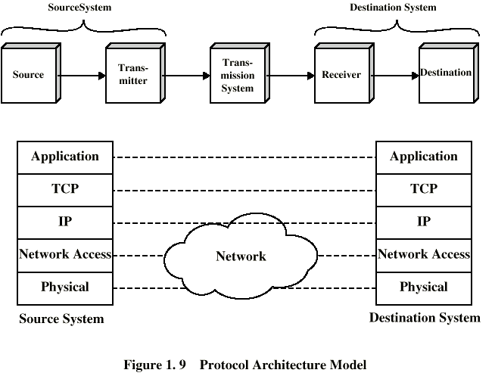
TCP/IP Protocol Architecture Model

Slide 36
The Internet
Explosive growth –
starts out as a research project of a few dozen nodes. Now, it spans 82 countries and has millions of nodes.
It has been growing exponentially since its inception.
Used in all Venues-
Government
Education
Private companies

Slide 37
History of the Internet
Late 60s—the U.S. government realizes the importance of allowing their research and development sites to electronically “talk” to each other. The government-funded Advanced Research Projects Agency(DARPA) created ARPANET in 1969.
Mid 1970’s – ARPA began to work on connecting computers in all associated agencies. The early Internet had emerged.

Slide 38
History of the Internet(cont’d)
Mid 1980’ – the Internet split into ARPANET and MILNET.
1986 – NSFNET began to work; the National Science Foundation funded a new wide area network that connected all of its supercomputing centers.
1996 – Telecommunications Reform Act.

Slide 39
Who run the Internet?
No one person, group or organization owns. The backbone of it is funded by the National Science Foundation in the U.S.
In addition, there is an Internet Engineering Task Force (IETF) and Internet Advisory Board (IAB) who help to set standards (TCP/IP) for those who wish to connect to, and use, the Internet.
The IAB makes its standard available via documents called RFC (Request for Comment).

Slide 40
What is TCP/IP?
TCP/IP stands for Transmission Control Protocol/Internet Protocol and is actually a set of standards that describe how data is to be transferred between computers.
TCP/IP is the common tongue that all computers must speak to communicate via Internet.
There are implementations for UNIX, Windows, Macintosh, and just about any computer operating systems you can think of.
TCP/IP is implemented as part of an Operating System.

Slide 41
Other Names of the Internet
ARPANET : the U.S. Department of Defense Advanced Research Projects (ARPA)
The TCP/IP Internet
The (Global) Internet

Slide 42
Physical Layer
Physical interface between data transmission device (e.g. computer) and transmission medium or network
Characteristics of transmission medium
Signal levels
Data rates
etc.

Slide 43
Network Access Layer
Exchange of data between end system and network
Destination address provision
Invoking services like priority

Slide 44
Internet Layer (IP)
Systems may be attached to different networks
Routing functions across multiple networks
Implemented in end systems and routers

Slide 45
Transport Layer (TCP)
Reliable delivery of data
Ordering of delivery

Slide 46
Application Layer
Support for user applications
e.g. http, SMPT

Slide 47
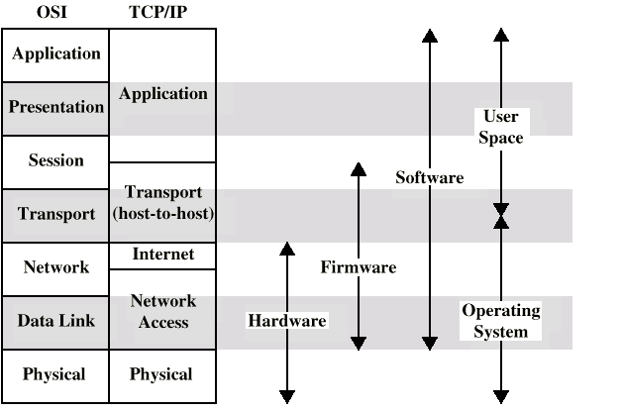
OSI v TCP/IP

Slide 48
Plethora of Terminology:where do they come from?
Hardware – switches, nodes, boxes, bridges, routers, gateways, etc.
Software – protocol, seven protocol layers, protocol stack, protocol suite, etc.
Market – computer venders “invent” new term to make a mint.
Politics – “the Information Highway”.
Computer research community – objected-oriented technology, CORBA(Common Object Request Broker Architecture), Java, JavaScript, Dynamic Java, Java 2, etc.

Slide 49
What’s Next? – Data Transmission
Two issues—
Medium
Form of energy
READING ASSIGNMENT:
Chapter 1 (ignoring some details)

Slide 50
Extra Reading Material
Stallings, W. Data and Computer Communications (6th edition), Prentice Hall 1999 chapter 1
Web site for Stallings book
www.shore.net/~ws/DCC6e.html
Web sites for IETF, IEEE, ITU-T, ISO
Internet Requests for Comment (RFCs)
Usenet News groups
comp.dcom.*
comp.protocols.tcp-ip

